Slide 1
A presentation on Multi Banking System

Slide 2
CONTENTS
INTRODUCTION
OVERVIEW
PURPOSE
SCOPE
FUNCTIONAL COMPONENTS
CUSTOMER MODULE
LOCATION MODULE
SOFTWARE REQUIREMENTS & SPECIFICATION
SOFTWARE REQUIREMENTS
HARDWARE REQUIREMENTS
TECHNOLOGIES USED
ENTITY RELATIONSHIP DIAGRAMS
OUTPUT SCREENS
CONCLUSION

Slide 3
INTRODUCTION
OVERVIEW
Internet Banking is all about knowing our customer need and provide them with the right service at the right time through right channel 24*7 day a week.
Being “electronic”, it not only provides its customers with faster and better facilities, it even reduces the manual overhead of accounts maintenance.

Slide 4
PURPOSE The Multi Banking suite provides a global accounting foundation that provides all user with electronic banking facilities of multiple retail and corporate sector banks using single portal. It allows client to carry out their day to day banking transactions. SCOPE The objective of this application is to provide the Customers of various Banks to access their account and do transactions using this website. They need not to interact with various applications or web sites of each bank.

Slide 5
FUNCTIONAL COMPONENTS
CUSTOMER MODULE
♦ Create New Account: User can create a new account in any bank by selecting bank name option.
♦ Credit Money: User can deposit money to his account from any place.
♦ Debit Money: User can withdraw money from his account from any place.
♦ View Account Information: User having account in any bank can view all his account details.
♦ Transfer Amount: User can transfer money from his account to other accounts of same bank or other banks.

Slide 6
LOCATION MODULE
In this module, customer can locate and can have the information about address, email and phone number of any bank’s branch or ATM in any city or village across India using Google maps.

Slide 7
SOFTWARE REQuIREMENTS & SPECIFICATION
SOFTWARE REQUIRED
The project is implemented in J2EE as it provides the implementation of Socket and Server Socket classes that are used to connect distinct applications, hence the software’s required in the creation and execution of the project are Eclipse .As we know JAVA is a platform independent language so this software runs with JRE environment on any desired platform i.e. Linux , windows 9x, XP, 2000, 7,8,10 or any operating system.

Slide 8
HARDWARE REQUIRED
Any System with Pentium P2 or above processor, 512MB RAM, 1GB Hard Disk, a LAN Card. Its network based software so computers connected with any kind of mode (wireless, LAN connected etc) will suit its requirements. It can also be run on a single machine for its demo use. TECHNOLOGIES USED IDE: Eclipse Juno Front End: JSP, JDBC, Javascript Programming Language: JAVA Back End: IBM Bluemix (DBDash)

Slide 9
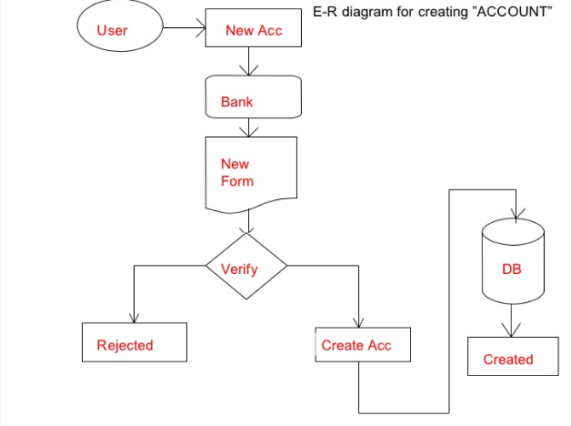
ENTITY RELATIONSHIP DIAGRAM
(1)

Slide 10
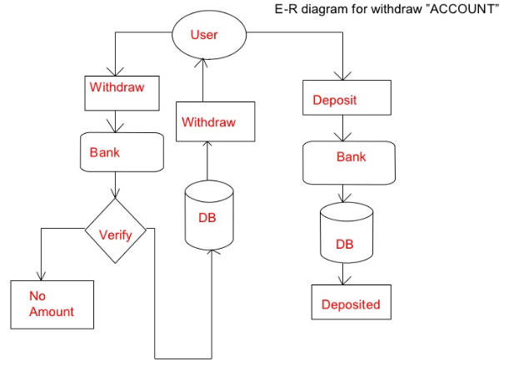
(2)

Slide 11
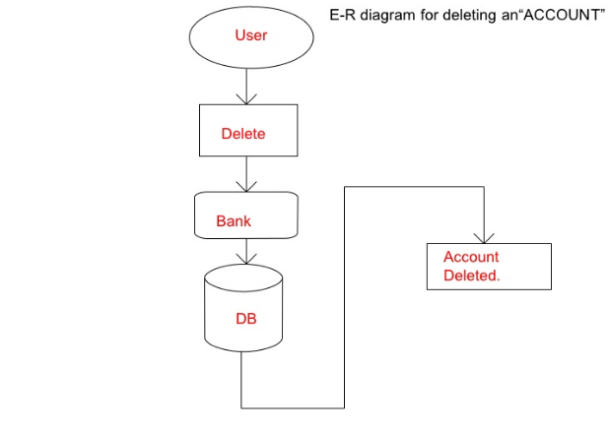
(3)

Slide 12
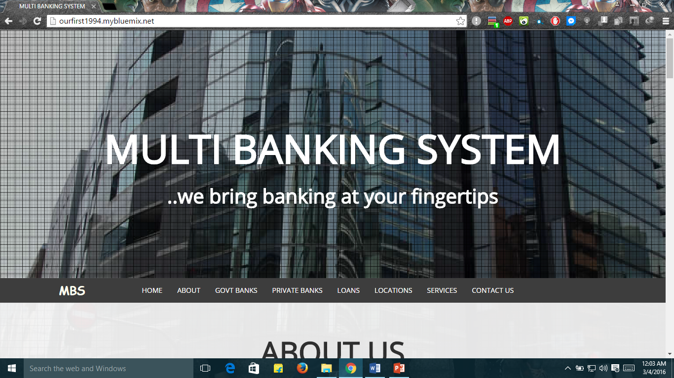
OUTPUT SCREENS
WELCOME PAGE

Slide 13
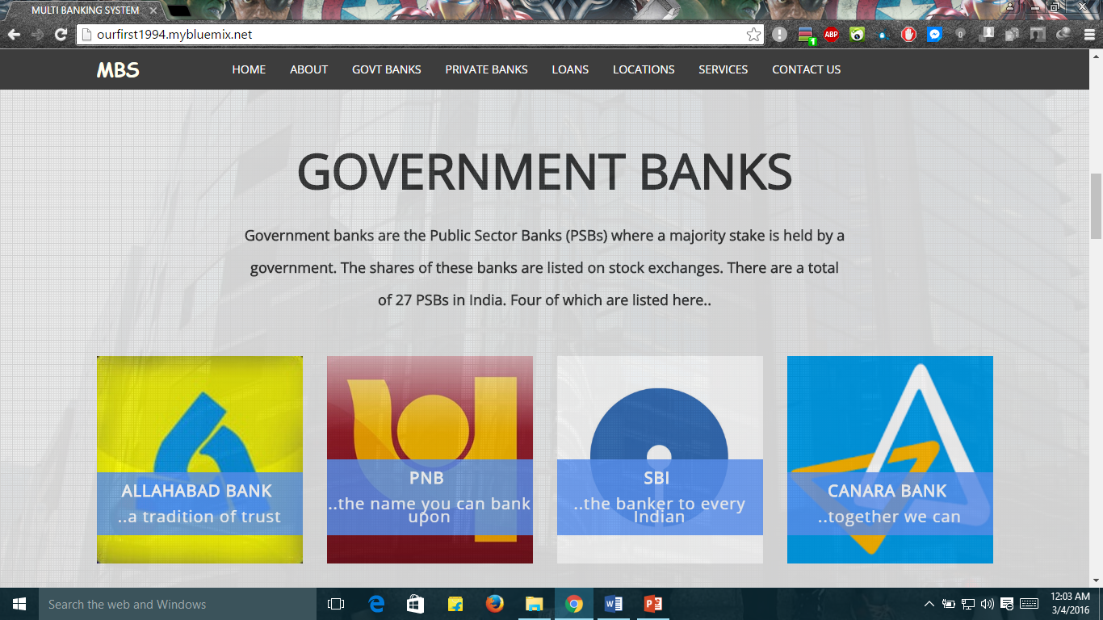
GOVERNMENT BANKS

Slide 14
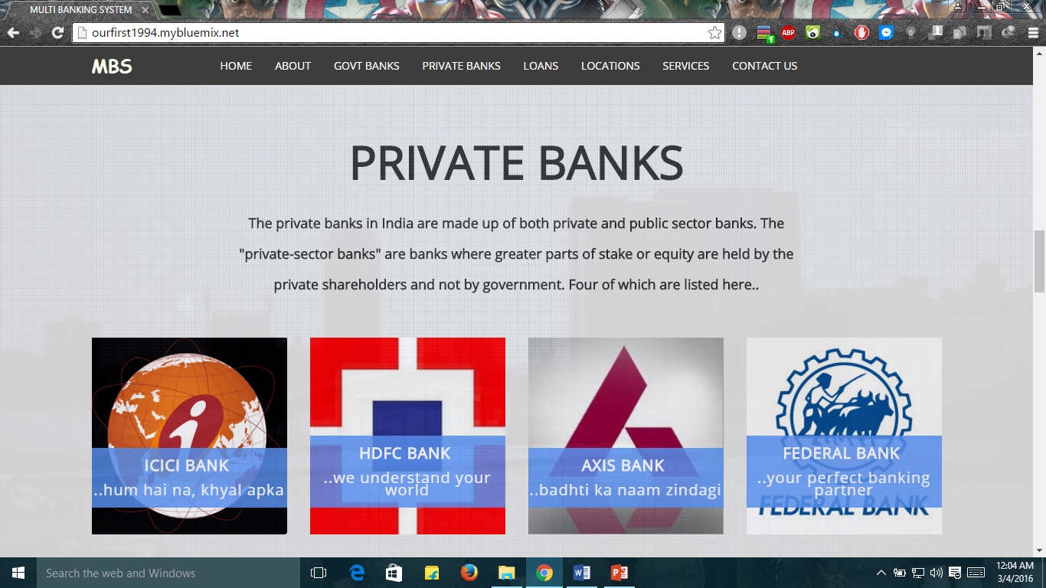
PRIVATE BANKS

Slide 15
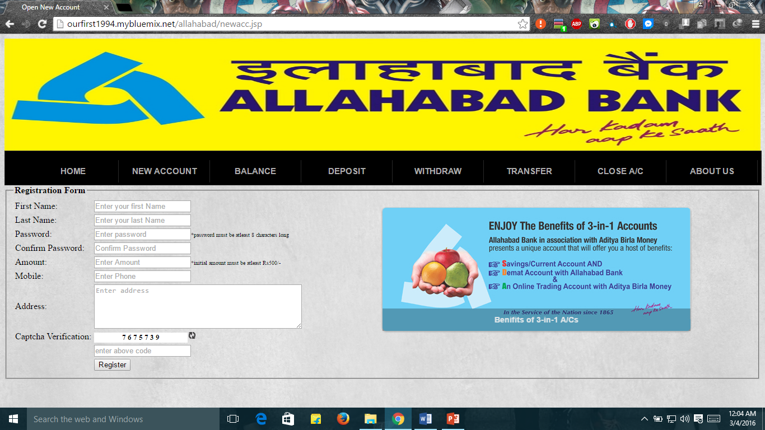
OPEN NEW ACCOUNT FORM

Slide 16
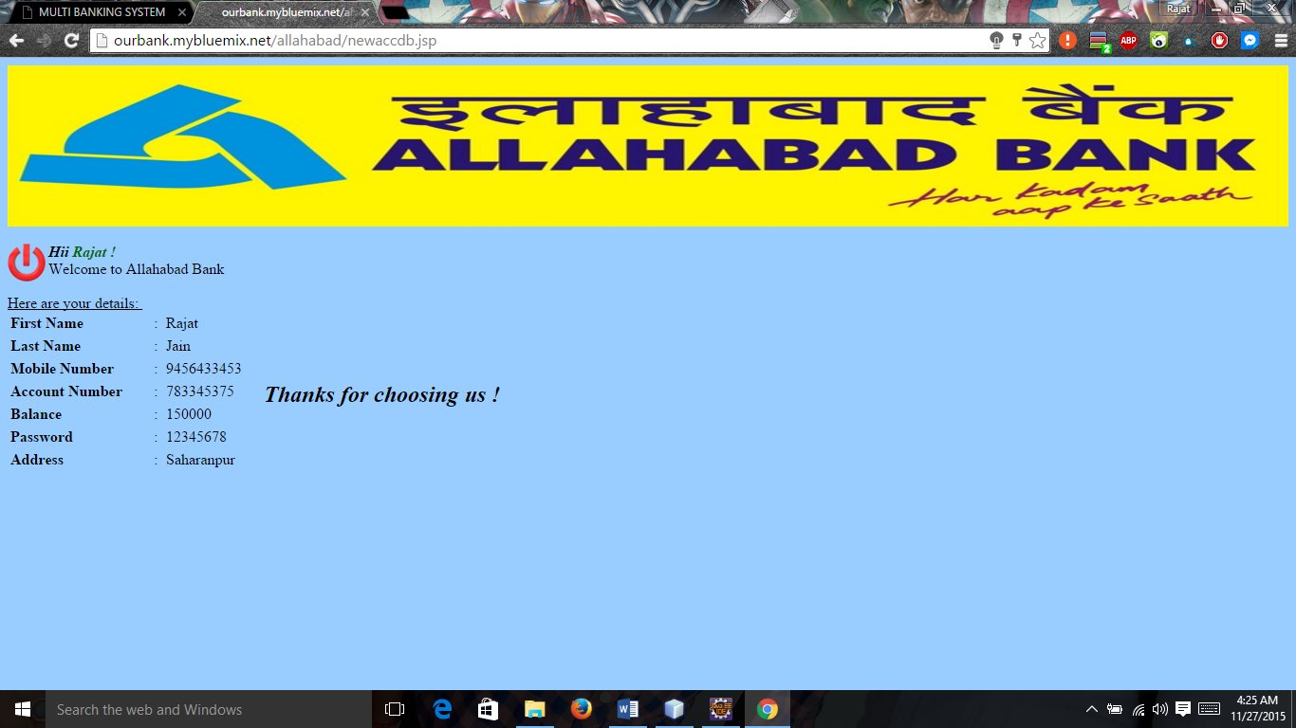
ON FILLING OF CORRECT DETAILS

Slide 17
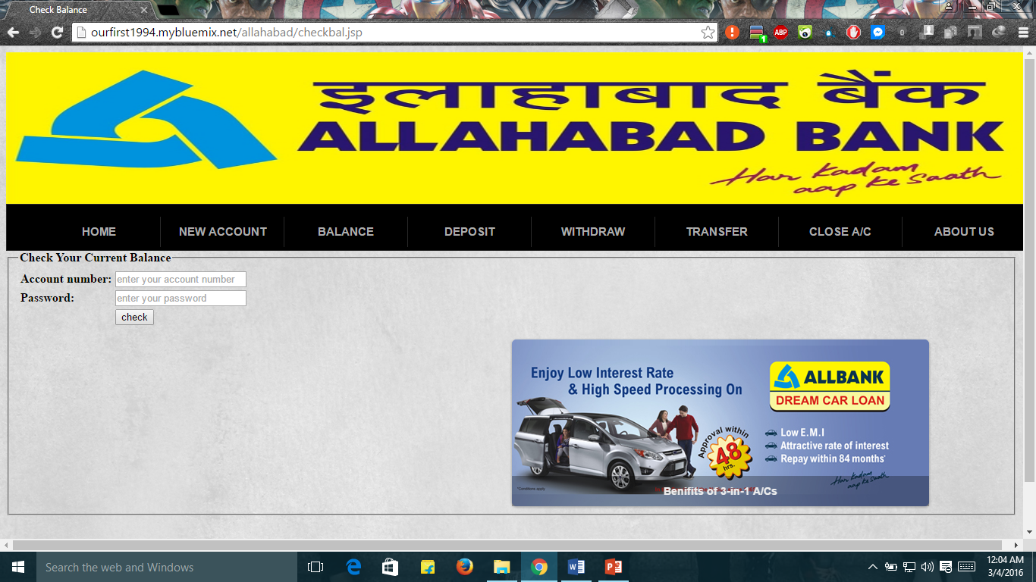
CHECK BALANCE FORM

Slide 18
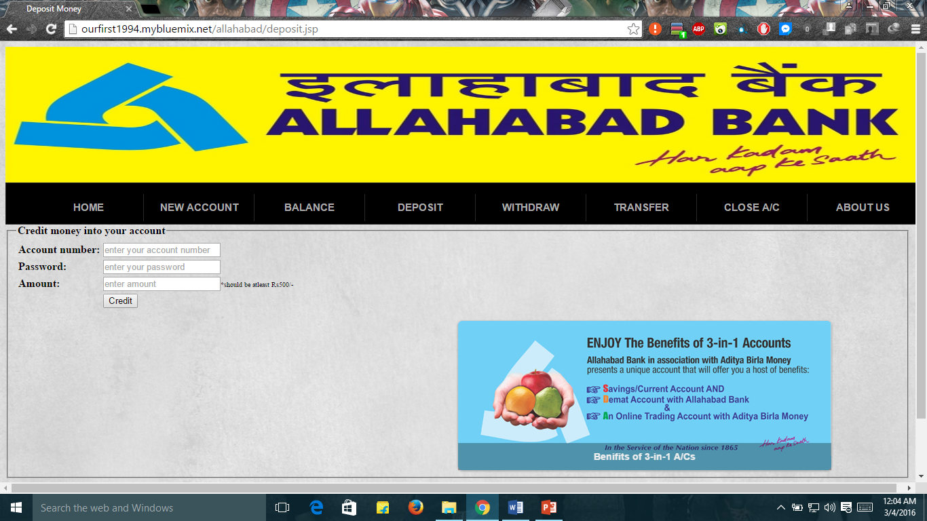
CREDIT MONEY FORM

Slide 19
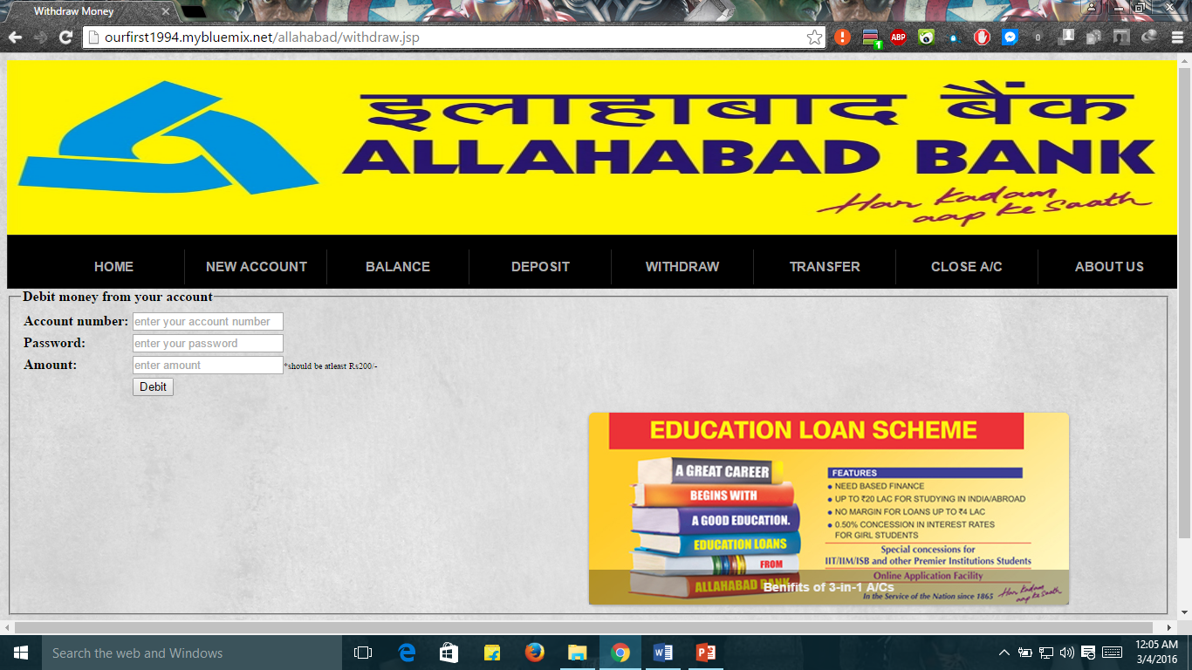
DEBIT MONEY FORM

Slide 20
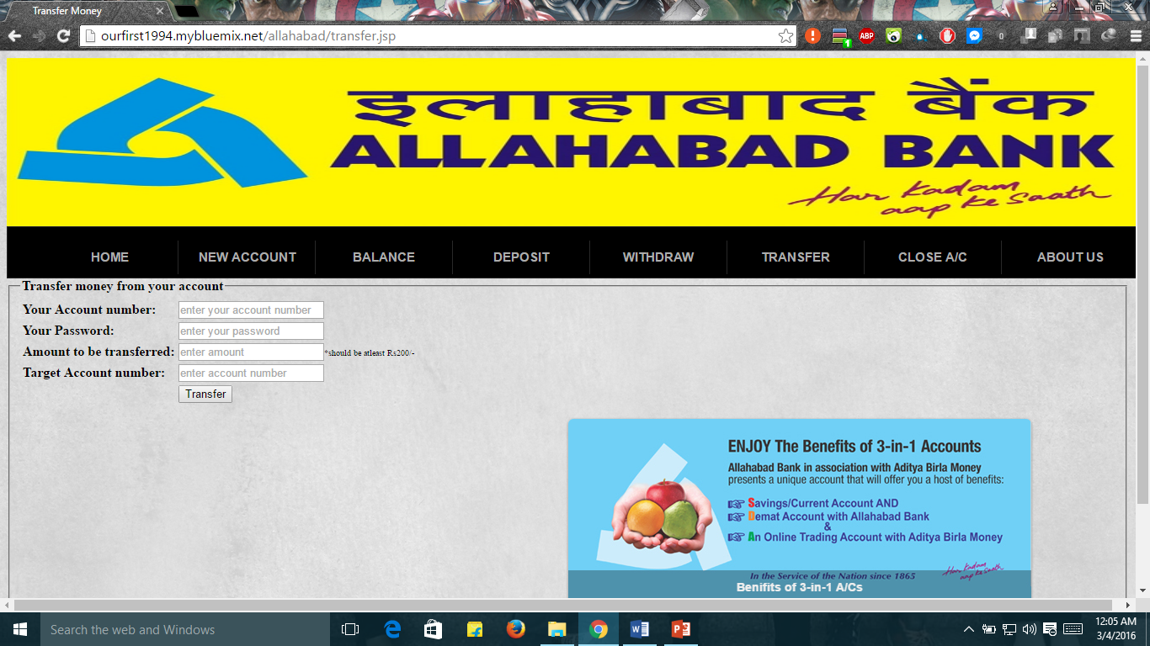
TRANSFER MONEY FORM

Slide 21
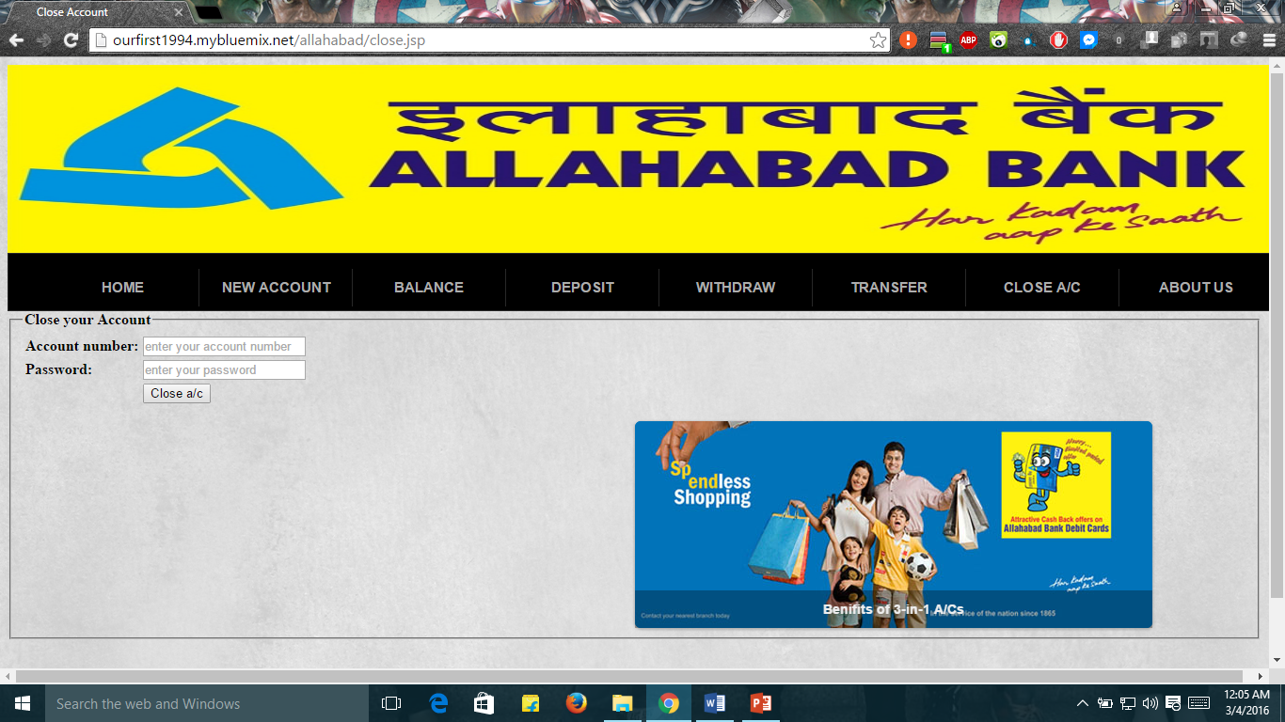
CLOSE ACCOUNT FORM

Slide 22
CONCLUSION
This project developed, incorporated all the activities involved in the browsing center.
It provides all necessary information to the management as well as the customer with the use of this system. The user can simply sit in front of the system and monitor all the activities without any physical movement of the file. Management can service the customer’s request best in time.

Slide 23
THANK YOU
Presented By:-
Rajat Jain
Rajat Agarwal

